Slide 1
Commission Recommendation on Code of practice on standardisation
Ioannis Sagias, Deputy head of Unit
Valorisation Policies & IPR Unit
Directorate-Generale for Research & Innovation
European Commission

Slide 2


Why Integrate Standards, Research & Innovation
Bridge the Innovation Gap for Impact at Global Scale
Risk
High
Low
Global
Markets
Scale
R&I
Results
2
Standards
Build Trust
& Confidence
Existing
Standards
Landscape
Research
1
Market / Technology Readiness Level
Standards De-risk & Accelerate Technology-Product-Service Development, Adoption & Scaling

Slide 3

ERA Action 7: Outcomes
Guiding principles for knowledge valorisation
Respond to the needs and feedback of R&I actors including policy making and provide a common reference to improve knowledge valorisation in the EU.
i) Code of practice on intellectual assets management
    Hands-on guidance for R&I actors on how to handle challenges related to intellectual asset management in the current R&I ecosystem.
ii) Code of practice on standardisation
    Hands-on guidance for R&I actors on how to create value of research results through standardisation.
Council Recommendation (EU) 2022/2415 adopted on 2 December 2022
Commission Recommendation adopted on 1 March 2023
Commission Recommendation adopted on 1 March 2023

Slide 4
Standardisation Strategy – the key actions
No alignment with political priorities
Enhance Annual WP to reflect standardisation urgencies
High-Level Forum to assist in priorisation
Review of all harmonised European standards against contribution to zero-emission economy and Europe’s Digital Decade
EU excellence hub and Chief Standardisation Officer
Good governance concerns
Proposal for amendment → introducing good governance principles for ESOs
Call to ESOs to modernise their governance
Announce the Evaluation of Regulation 1025/2012
MS peer review process on SME-friendly conditions
Geopolitics of standards
Coordination of EU MS/NSB positions
International standards for a free, open and secure global internet
EU funding (Horizon, NICI), pilots in African countries and EU Neighbourhood
Continuation of concerted actions with like-minded partners (TTC, Japan)
Unexploited potential of pre-normative work
Code of Practice for researchers
Standardisation Booster
Lack of experts
Targeted actions on education and skills:
  Horizon Europe/COST
  EU Academy Platform/e-learning material
  Standardisation University Days

Slide 5
Objective of the code of practice on standardisation
Supporting our stakeholders to valorise their R&I results through standardisation by
  Contributing to the synchronisation and systemic integration of R&I and standardisation
  Providing guidance to researchers and innovators

Slide 6
Process for establishing the Code
Survey with beneficiaries – May-June 2021
Scoping study – June 2021-March 2022
Publication of the first draft of the Code – 19 May 2022
Stakeholder consultation – May – June 2022
Code published 1 March 2023
Matrix Group on Standardisation
Standards Development Organisations
Practitioners
Member States
https://op.europa.eu/en/publication-detail/-/publication/94a9bba7-a43b-11ec-83e1-01aa75ed71a1/language-en/format-PDF/source-253037686

Slide 7
Recommendations addressed at 3 main stakeholder groups
Based on the lessons learnt and success factors from examples of Horizon 2020 projects
Higher education institutions and research & innovation organisations
Project partners
Policy and stakeholders
Inclusiveness – all types of projects with a wide range of TRLs

Slide 8
Higher education institutions and research and innovation organisations

Slide 9
Project partners

Slide 10
Policy and stakeholders

Slide 11
More information
Find out more information about the Code of practice:
  Guiding Principles for Knowledge Valorisation implementing Codes of Practice (europa.eu)
  Commission adopts Recommendations on codes of practice for the management of intellectual asset and standardisation (europa.eu)
  Factsheet: Code of practice on standardisation in the European Research Area - Publications Office of the EU (europa.eu)

Slide 12

Activities supporting the implementation of knowledge valorisation
Awareness raising campaign (18 months)
  “Tour des capitales” (national events)
  3 stakeholder events in Brussels
  Training days on intellectual assets and standardisation
  Additional events organised by stakeholders
Mutual learning exercise
  Focus on skills, intersectoral cooperation and incentive systems
EU Knowledge Valorisation Platform
https://research-and-innovation.ec.europa.eu/research-area/industrial-research-and-innovation/eu-valorisation-policy/knowledge-valorisation-platform_en

Slide 13

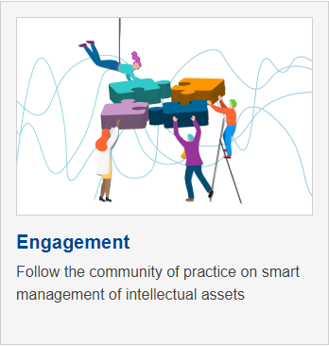

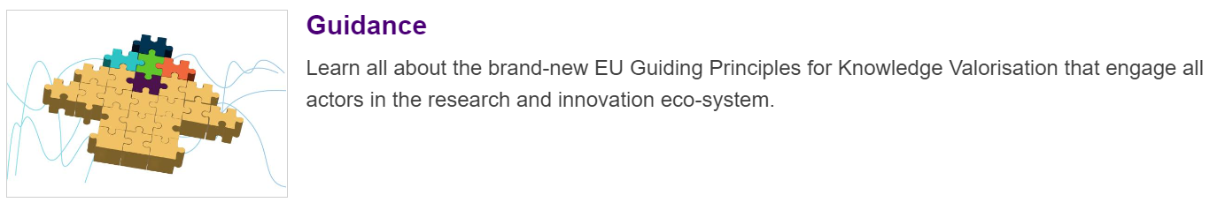
EU Knowledge Valorisation Platform
Visit the platform and submit your best practice:
Knowledge Valorisation Platform (europa.eu)

Slide 14
New Codes of Practice
Code of Practice on Industry – Academia co-creation
Share your views until 20 October in the online survey here
Code of Practice on Citizens engagement
Share your views until 20 October in the online survey here
Read more in the article in the Knowledge Valorisation Platform

Slide 15

Thank you
© European Union 2023
Unless otherwise noted the reuse of this presentation is authorised under the CC BY 4.0 license. For any use or reproduction of elements that are not owned by the EU, permission may need to be sought directly from the respective right holders.
Slide01: ©luismolinero #281962386, 2023. Source : stock.adobe.com. Slide xx: element concerned, source: e.g. stock.adobe.com

