Slide 1
Council recommendation on the guiding principles for knowledge valorisation
Dr. Tomaž Boh, acting DirGen Science and Innovation Directorate
Awareness raising campaign on knowledge valorisation,
Grand Hotel Union, 11 October 2023

Slide 2



Introduction
[The importance of knowledge valorization]
Maximizing Economic and Societal Value
Accelerating Innovation
Enhancing Research Impact

Slide 3

Historical overview – most important documents
10 April 2008
Comission Recomm.
29 May 2018
Council Concl.
1 Dec. 2020
Council Concl.
26 Nov. 2021
Council Concl.
26 Nov. 2021
Council Recomm.

Slide 4
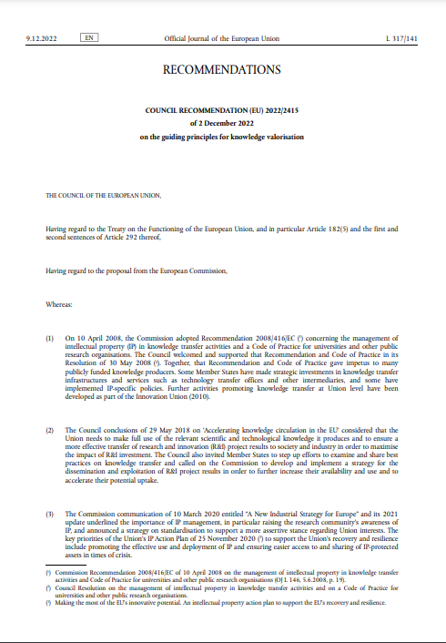
Council recommendations on the guiding principles for knowledge valorisation
2 December 2022

Slide 5
Main difference / development
2008
KNOWLEDGE TRANSFER
Focus on technology
2022
KNOWLEDGE VALORISATION
broader scope
includes all actors from the R&I ecosystem
all types of intellectual assets beyond technology and IPR
Focus on commercialization

Slide 6

7 guiding principles for knowledge valorisation
principles
KV
in R&I policy
Skills and capacities
Peer learning
Metrics, monitoring and evaluation
Relevance in public funding schemes
Intellectual asset management
System of incentives

Slide 7

Knowledge valorisation in R&I policy
Support structures, resources, policies, strategies and practices;
Broadest possible societal utilisation of R&I intellectual assets involving all ecosystems;
Policy uptake and standards;
Promoting equality, diversity and inclusion

Slide 8

Skills and capacities
Competences, skills and capacities for all stakeholders
academia-industry-public sector mobility
participatory approaches to include talent, skills and tacit knowledge in valorisation
multidisciplinary collaborations, co-creation, social sciences, humanities and arts

Slide 9

System of incentives
All research and innovation ecosystem actors to learn, apply and practice knowledge valorisation;
businesses, SMEs, civil society, citizens, end-users and public authorities to be active partners in co-creation and joint experimentation;
incentivise actors to collect, share and use metrics that improve learning and performance of knowledge valorisation

Slide 10

Intellectual asset management
Policies and practices at organisational level;
awareness in international environment and sovereignty;
maximising socio-economic benefit for EU including contribution to sustainability;
awareness and uptake of practices and tools in Open Science and Open Innovation;
efficiency e.g. by supporting portfolio building and platforms linking offer and demand

Slide 11

Relevance in public funding schemes
Application of valorisation principles in publicly funded research;
specific funding to incentivise valorisation early on in research including support to intermediaries

Slide 12

Peer learning
Peer-learning, sharing of best-practices and developing common specifications;
benchmarking to develop and promote common concepts, models and incentives

Slide 13

Metrics, monitoring and evaluation
Adopt common definitions, metrics and indicators encompassing variety of valorisation channels;
monitoring and evaluation aligned with ERA monitoring framework.

Slide 14
Conclusion - potential impact of implementing the Guiding principles for knowledge valorization
Embracing knowledge valorization principles fosters a culture of innovation where creativity, experimentation, and risk-taking should be encouraged.

Slide 15
Thank you!
Dr. Tomaž Boh, acting DirGen Science and Innovation Directorate
Awareness raising campaign on knowledge valorisation,
Grand Hotel Union, 11 October 2023

